Slide 1
SS855 – Research Methodology In Applied Sciences
Seminar on
Standard Methods In Preparing A Questionnaire
Submitted to, Submitted by,
Dr. Smitha Chandran S., Anju Ramachandran,
Assistant Professor, AM.PS.R4PHY24002,
Department of Chemistry. Department of Physics.

Slide 2
Contents
Introduction
Definitions
Characteristics of a Good Questionnaire
Sample Questionnaire
Elements of a Questionnaire
Types of Questionnaire
Standard methods in Preparing a Questionnaire
Distributing Questionnaires
Advantages
Disadvantages

Slide 3

Questionnaire
A research tool consisting of a set of questions to collect data from a set of respondents.
Invented by Sir Francis Galton.
Questions are printed or typed in a definite order on a form or set of forms.
It is mailed to respondents who are expected to read and understand the questions and write down the reply in the space meant for the purpose in the questionnaire itself.
The respondents must answer the questions on their own.

Slide 4

Definitions
Bogardus
A questionnaire is list of questions to a number of persons for them to answer.
Goode and Hatt
In general, the word questionnaire refers to a device for securing answers to questions by using a form which the respondent fills in himself.
Wilson Gee
It does constitute a convenient method of obtaining a limited amount of information from a large number of persons or from a small selected group which is widely scattered.

Slide 5
Characteristics of a Good Questionnaire
Should be concerned with specific and relevant topic.
Should be short.
Directions and wording should be simple and clear.
Questions should be objective.
There should always be provision for indications of uncertainty, e.g., “do not know,” “no preference” and so on.
Embarrassing and hypothetical questions should be avoided.
Should be presented in a good order.
Should be attractive and neatly printed.

Slide 6
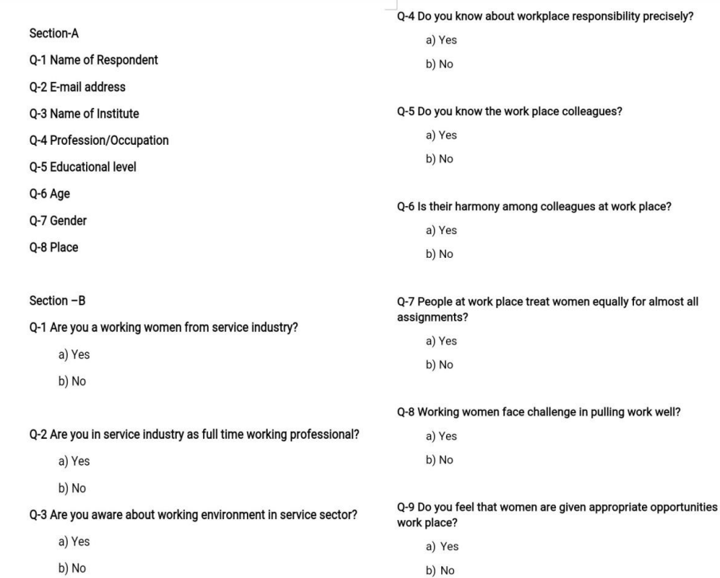
Sample Questionnaire

Slide 7
Elements of a Questionnaire
Title
General introduction
Specific instructions
Questionnaire items
Additional informations

Slide 8
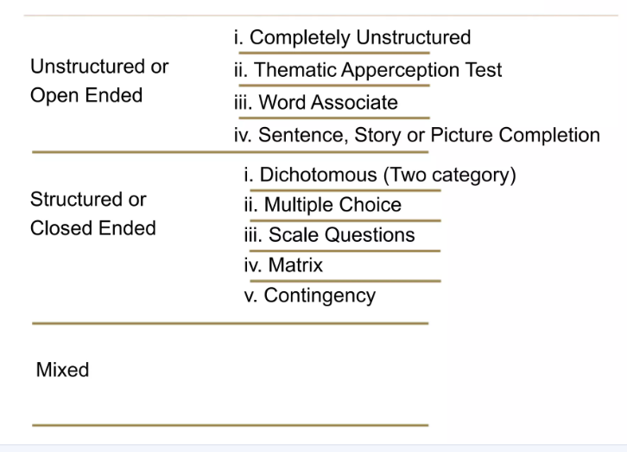
Types of Questionnaire

Slide 9
Unstructured or Open-Ended Questionnaire
Don’t have predetermined set of responses.
Gives opportunity to the respondents to express their opinions in a free-flowing manner.
4 types
Completely Unstructured
Thematic Apperception Test
Word Associate
Sentence, Story or Picture Completion

Slide 10
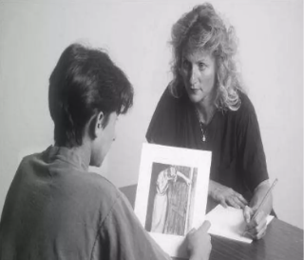

Completely Unstructured – to get the opinion, view or feelings of the respondent.
What are the facilities do you expect from your institution?
Thematic Apperception Test – responds analysed in terms of any theme, conflicts, motivation, interests etc.
Word Associate – words are presented, and the respondent mentions the first word that comes to mind.
Family – love
1857 – revolt
Sentence, Story or Picture Completion – respondent completes an incomplete sentence, story.

Slide 11

Structured or Closed-Ended Questionnaire
Planned and designed to collect very specific information.
5 types
Dichotomous (two category)
Multiple Choice
Scale Questions
Matrix
contingency

Slide 12
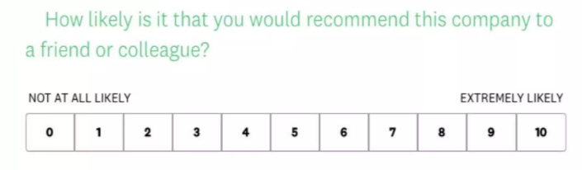
Dichotomous
Yes/No
True/False
Agree/Disagree
Have you ever experienced a service from online shop?
Multiple Choice
What factors influence your purchasing decisions the most? A) Price B) Quality C) Brand reputation D) Product features
Scale Questions

Slide 13
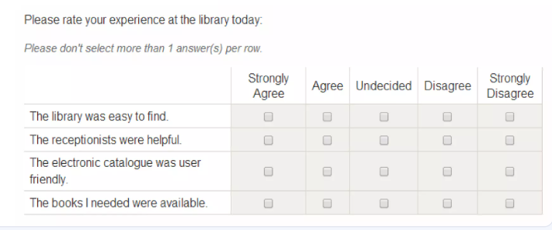
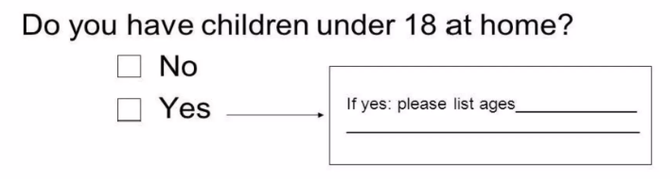
Matrix – MCQ represented in a grid format
Contingency – a question that is answered only if the respondent gives a particular response to a previous question

Slide 14
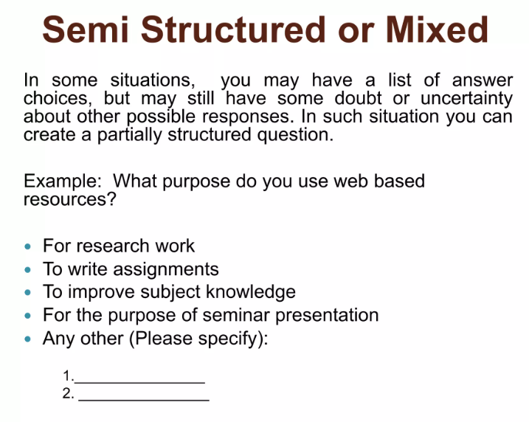

Slide 15
Standard Methods in Preparing a Questionnaire
Specify the information needed.
Type of interviewing method.
Individual question content.
Overcoming inability to answer.
Overcoming unwillingness to answer.
Choosing question structure.
Choosing question wording.
Determining the order of questions.

Slide 16
Distributing Questionnaires
Computer Questionnaire
Telephone questionnaire
Mail Questionnaire
In – House Questionnaire

Slide 17
Advantages
It is economical.
Wide coverage is possible.
In short period of time valid information can be collected.
Respondents have enough time to think and answer.
Free from the bias of the interviewer.
It puts less pressure on the respondents

Slide 18
Disadvantages
The risk of incomplete information is high.
The rate of non-response is high.
It can be used only when respondents are educated and cooperating.
Lack of personal contact.
Greater possibility of wrong answers.
This method is likely to be the slowest of all.

Slide 19


